Slide 1
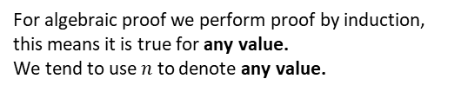
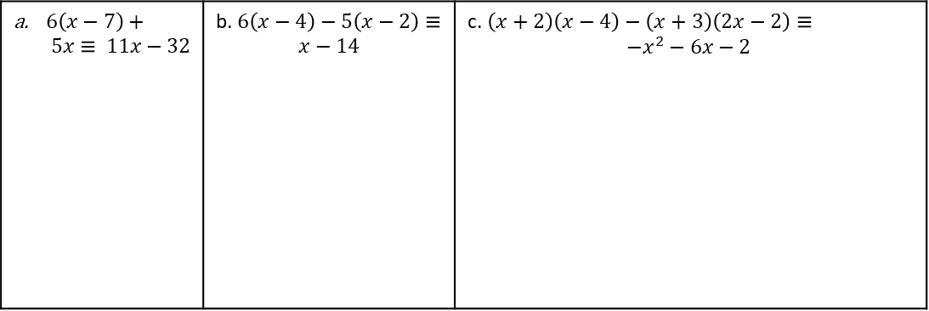
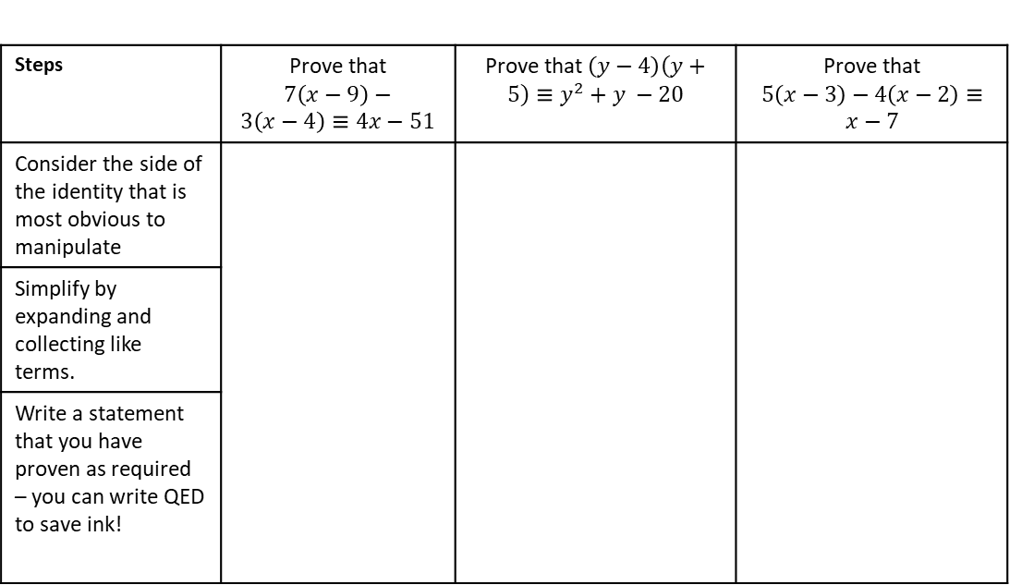
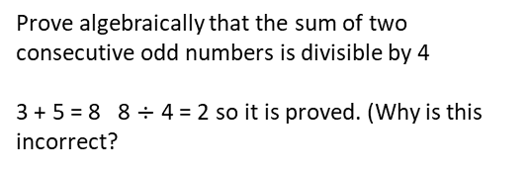
Subtopic 7 – Algebraic Proof
LEARNING OUTCOME: To understand algebraic proof.
Objectives:
Keywords:
Proof
To be able to prove statements algebraically.
You will have encountered the word “proof” many times in your life. To prove something mathematically can be very challenging. You formally met this concept in a tricky context in in Year 10 with the algebraic approach to proving that recurring decimals can be written as equivalent fractions. GCSE exams may ask you to prove other statements are true.
Direct algebraic proof works by manipulating one side of a mathematical identity in order to make it exactly equal to the other to the other side. Whilst working through these proofs we will refer to the LHS (left hand side) and RHS (right hand side) of the identity, the first statement we make is ‘Consider the LHS’. We then manipulate the LHS until it equals the RHS. This is a helpful introduction to the idea of proof.
Definition
Characteristics
A structured argument that follows a sequence of logical steps using facts and theorems to prove if a mathematical statement is true.
For algebraic proof we perform proof by induction, this means it is true for any value.
We tend to use $n$ to denote any value.
Example 1- I do…
Example 2 - We do…
Example 3 - You do…
Examples
Proof
Non - Examples
Steps | Prove that $7\left(x−9\right)−3\left(x−4\right)≡4x−51$ | Prove that $\left(y−4\right)\left(y+5\right)≡y^{2}+y −20$ | Prove that $5\left(x−3\right)−4\left(x−2\right)≡x−7$
Consider the side of the identity that is most obvious to manipulate
Simplify by expanding and collecting like terms.
Write a statement that you have proven as required – you can write QED to save ink!
Prove algebraically that the sum of two consecutive odd numbers is divisible by 4
2n + 1 + 2n + 3 = 4n + 4 = 4(n + 1)
Prove algebraically that the sum of two consecutive odd numbers is divisible by 4
3 + 5 = 8 8 $÷$ 4 = 2 so it is proved. (Why is this incorrect?
INDEPENDENT PRACTICE
1. Prove the following statements are true:
$6\left(x−7\right)+ 5x≡ 11x−32$ | b. $6\left(x−4\right)−5\left(x−2\right)≡$ $$x−14$$ | c. $\left(x+2\right)\left(x−4\right)−\left(x+3\right)\left(2x−2\right)≡$ $$−x^{2}−6x−2$$
1

Slide 2
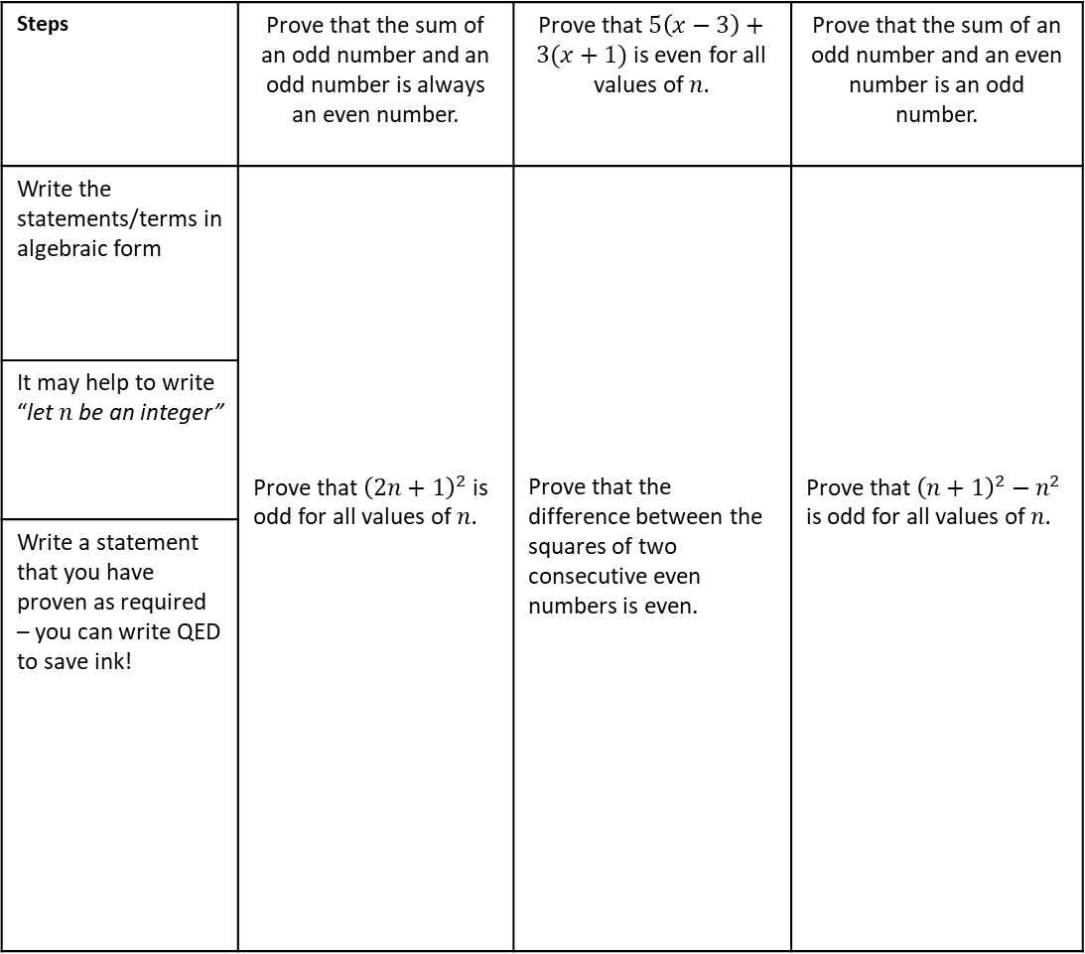
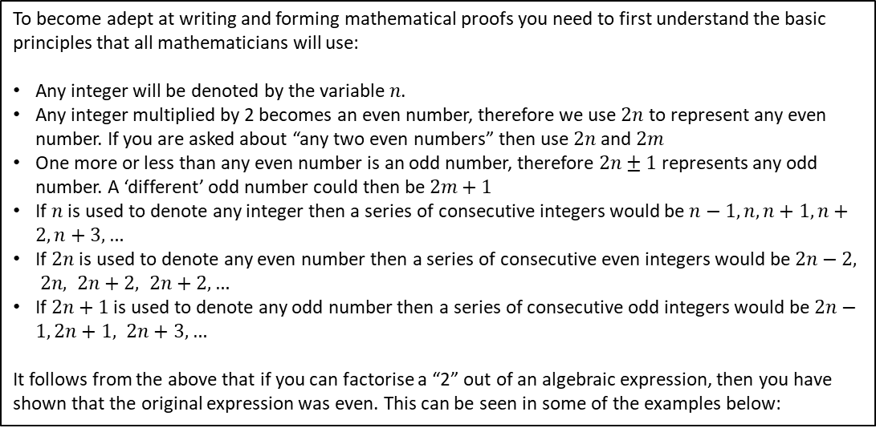
ALGEBRAIC PROOF: PRINCIPLES OF NOTATION
To become adept at writing and forming mathematical proofs you need to first understand the basic principles that all mathematicians will use:
Any integer will be denoted by the variable$n$.
Any integer multiplied by 2 becomes an even number, therefore we use $2n$ to represent any even number. If you are asked about “any two even numbers” then use $2n$and $2m$
One more or less than any even number is an odd number, therefore $2n±1$represents any odd number. A ‘different’ odd number could then be $2m+1$
If $n$ is used to denote any integer then a series of consecutive integers would be $n−1,n,n+1,n+2,n+3,…$
If $2n$ is used to denote any even number then a series of consecutive even integers would be $2n−2, 2n, 2n+2, 2n+2,…$
If $2n+1$ is used to denote any odd number then a series of consecutive odd integers would be $2n−1, 2n+1, 2n+3,…$
It follows from the above that if you can factorise a “2” out of an algebraic expression, then you have shown that the original expression was even. This can be seen in some of the examples below:
Definition
Characteristics
A structured argument that follows a sequence of logical steps using facts and theorems to prove if a mathematical statement is true.
For algebraic proof we perform proof by induction, this means it is true for any value.
We tend to use $n$ to denote any value.
Example 5 - We do…
Examples
Proof
Non - Examples
Example 4 - I do…
Example 6 - You do…
Prove algebraically that the sum of two consecutive odd numbers is divisible by 4
2n + 1 + 2n + 3 = 4n + 4 = 4(n + 1)
Prove algebraically that the sum of two consecutive odd numbers is divisible by 4
3 + 5 = 8 8 $÷$ 4 = 2 so it is proved. (Why is this incorrect?
Steps | Prove that the sum of an odd number and an odd number is always an even number. | Prove that $5\left(x−3\right)+3(x+1)$ is even for all values of $n.$ | Prove that the sum of an odd number and an even number is an odd number.
Write the statements/terms in algebraic form | Prove that ${\left(2n+1\right)}^{2}$ is odd for all values of $n.$ | Prove that the difference between the squares of two consecutive even numbers is even. | Prove that ${\left(n+1\right)}^{2}−n^{2}$ is odd for all values of $n.$
It may help to write “let $n$be an integer”
Write a statement that you have proven as required – you can write QED to save ink!
2

Slide 3
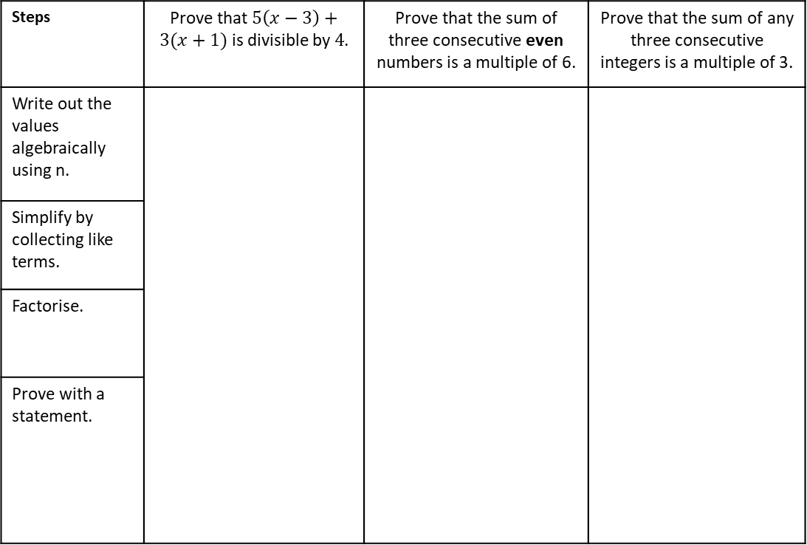
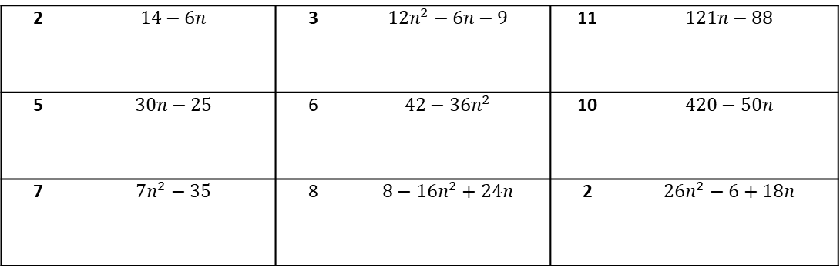
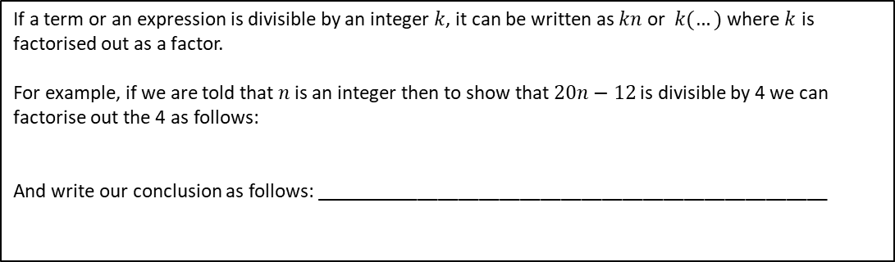
ALGEBRAIC PROOF: PROOF OF DIVISIBILITY
If a term or an expression is divisible by an integer$k$, it can be written as $kn$ or $k(…)$ where $k$ is factorised out as a factor.
For example, if we are told that $n$is an integer then to show that $20n−12$is divisible by 4 we can factorise out the 4 as follows:
And write our conclusion as follows: __________________________________________________
INDEPENDENT PRACTICE
1. Prove that the following expressions are divisible by the factors listed in bold.
Characteristics
2 | $$14−6n$$ | 3 | $$12n^{2}−6n−9$$ | 11 | $$121n−88$$
5 | $$30n−25$$ | 6 | $$42−36n^{2}$$ | 10 | $$420−50n$$
7 | $$7n^{2}−35$$ | 8 | $$8−16n^{2}+24n$$ | 2 | $$26n^{2}−6+18n$$
Definition
For algebraic proof we perform proof by induction, this means it is true for any value.
We tend to use $n$ to denote any value.
A structured argument that follows a sequence of logical steps using facts and theorems to prove if a mathematical statement is true.
Examples
Proof
Non - Examples
Prove algebraically that the sum of two consecutive odd numbers is divisible by 4
2n + 1 + 2n + 3 = 4n + 4 = 4(n + 1)
Prove algebraically that the sum of two consecutive odd numbers is divisible by 4
3 + 5 = 8 8 $÷$ 4 = 2 so it is proved. (Why is this incorrect?
Example 1- I do…
Example 2 - We do…
Example 3 - You do…
Steps | Prove that $5\left(x−3\right)+3(x+1)$ is divisible by$4$. | Prove that the sum of three consecutive even numbers is a multiple of 6. | Prove that the sum of any three consecutive integers is a multiple of 3.
Write out the values algebraically using n.
Simplify by collecting like terms.
Factorise.
Prove with a statement.
3

Slide 4
Steps | Example 4- I do…
1) Write out the values algebraically using n. 2) Simplify by collecting like terms. 3) Factorise (if it is required) 4) Prove with a statement. | Prove algebraically that the sum of any two consecutive integers is always an odd number
 | Example 5 - We do…
 | Prove that the difference between the squares of two consecutive odd numbers is a multiple of 8.
 | Example 6 - You do…
 | n is an integer. Prove algebraically that the sum of n(n + 1) and n + 1 is always a square number.

Slide 5
INDEPENDENT PRACTICE
1) Prove algebraically that the sum of two consecutive odd numbers is divisible by 4
2) I think of two consecutive integers. Prove that the difference of the squares of these integers is equal to the sum of the two integers.
3) Prove (n + 6)² − (n + 2)² is always a multiple of 8
.
5

Slide 6
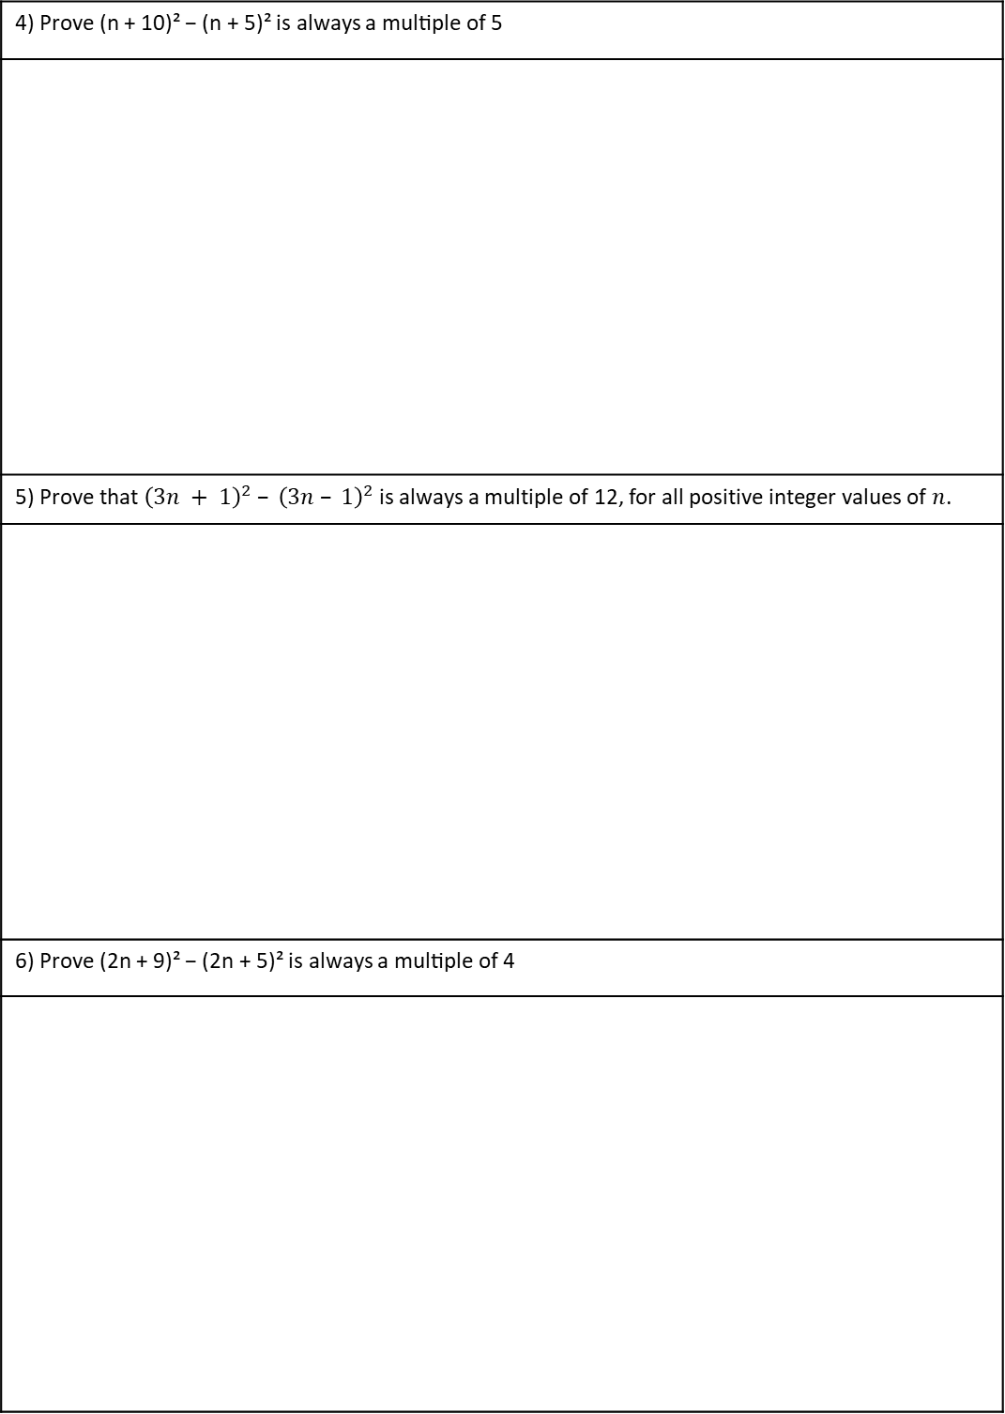
4) Prove (n + 10)² − (n + 5)² is always a multiple of 5
5) Prove that ${\left(3n + 1\right)}^{2} – {\left(3n – 1\right)}^{2}$is always a multiple of 12, for all positive integer values of $n$.
6) Prove (2n + 9)² − (2n + 5)² is always a multiple of 4

Slide 7
7) Prove that when two consecutive integers are squared, that the difference is equal to the sum of the two consecutive integers
8) Prove that (2n + 1)(3n − 2) − (6n − 1)(n − 2) is always even
9) Prove the product of three consecutive odd numbers is odd

Slide 8
10) Prove algebraically that (4n + 1)² − (2n − 1) is an even number for all positive integer values of n.
11) Prove that the sum of the squares of any three consecutive odd numbers is always 11 more than a multiple of 12.
12) Prove that the difference between two consecutive cubes is one more than a multiple of 6.

Slide 9
13) Prove that there is exactly one sequence of five consecutive positive integers in which the sum of the squares of the first three integers is equal to the sum of the squares of the other two integers.
14) Prove that the product of four consecutive numbers is one less than a square number.

Slide 10
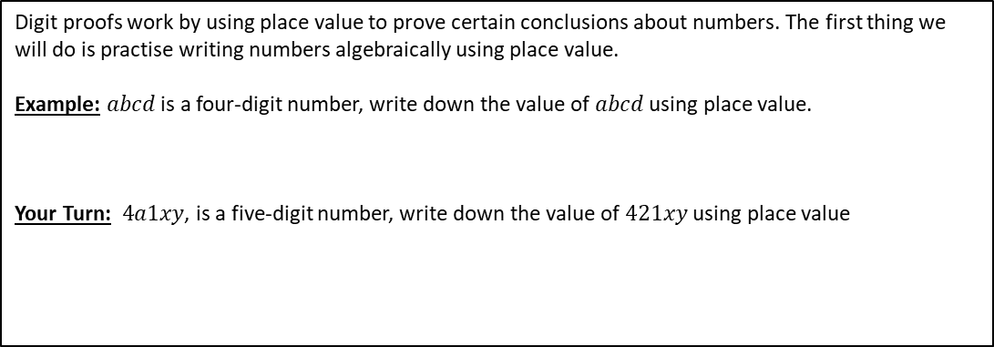
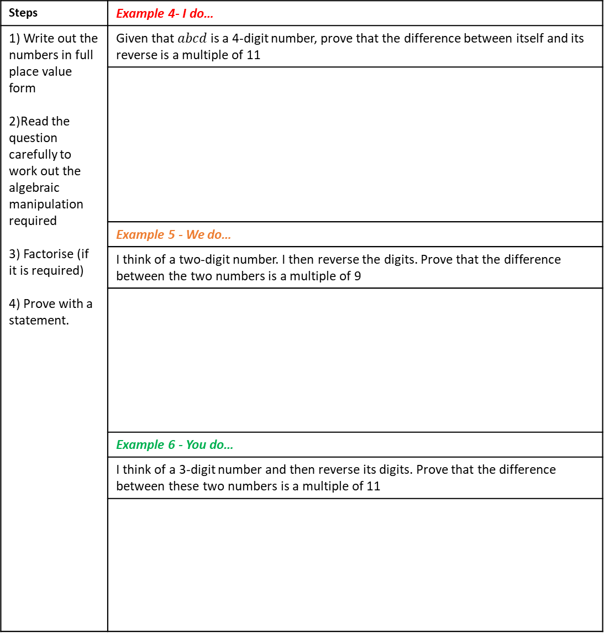
ALGEBRAIC PROOF: DIGIT PROOFS
Digit proofs work by using place value to prove certain conclusions about numbers. The first thing we will do is practise writing numbers algebraically using place value.
Example: $abcd$ is a four-digit number, write down the value of $abcd$ using place value.
Your Turn:$4a1xy$, is a five-digit number, write down the value of $421xy$ using place value
Steps | Example 4- I do…
1) Write out the numbers in full place value form 2)Read the question carefully to work out the algebraic manipulation required 3) Factorise (if it is required) 4) Prove with a statement. | Given that $abcd$ is a 4-digit number, prove that the difference between itself and its reverse is a multiple of 11
 | Example 5 - We do…
 | I think of a two-digit number. I then reverse the digits. Prove that the difference between the two numbers is a multiple of 9
 | Example 6 - You do…
 | I think of a 3-digit number and then reverse its digits. Prove that the difference between these two numbers is a multiple of 11

Slide 11
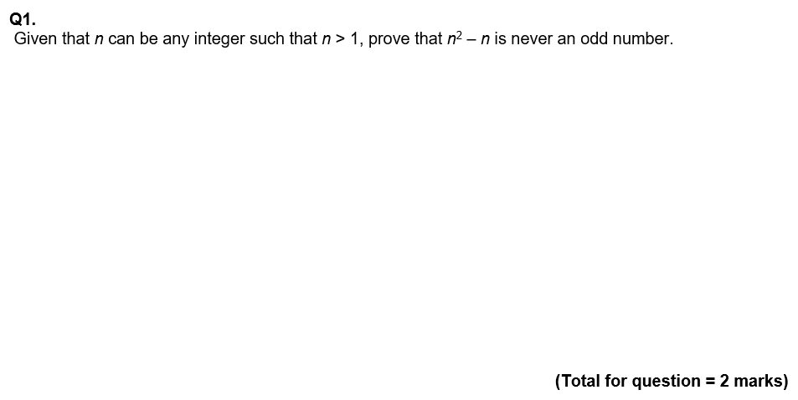
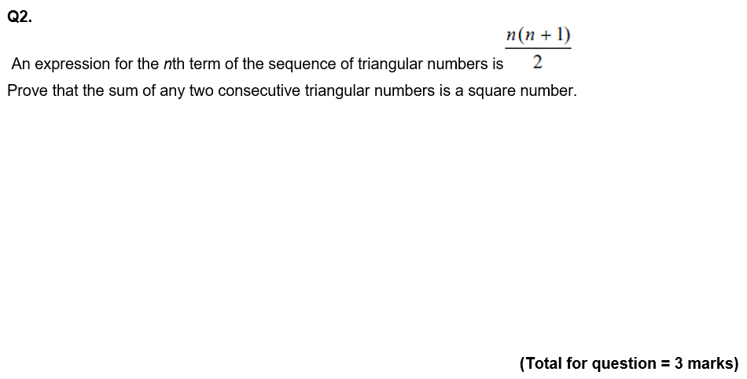
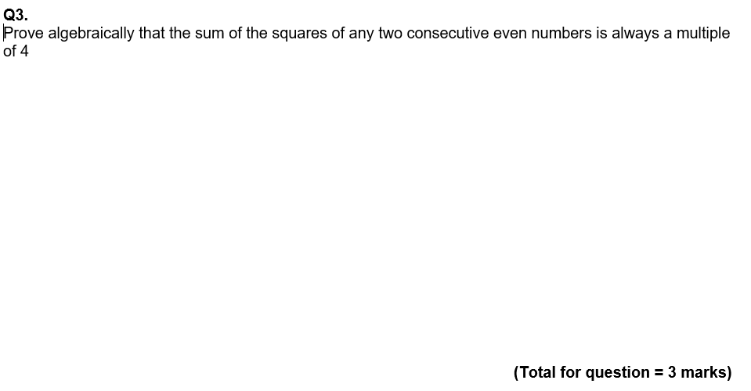
GCSE QUESTIONS

Slide 12
